Slide 1
CIS 470 Mobile App Development
Lecture 9
Wenbing Zhao
Department of Electrical Engineering and Computer Science
Cleveland State University

Slide 2
Displaying Pictures and Menus with Views
ImageSwitcher, GridView, ImageView
Display options menus and context menus
WebView: display web content

Slide 3
ImageSwitcher
ImageSwitcher enables the display of pictures with some animation
Using Android Studio, create a new Android project and name it ImageSwitcher
Modify the activity_main.xml

Slide 4
<?xml version="1.0" encoding="utf-8"?> <RelativeLayout xmlns:android="http://schemas.android.com/apk/res/android" xmlns:tools="http://schemas.android.com/tools" android:layout_width="match_parent" android:layout_height="match_parent" tools:context=".MainActivity"> <Button android:text="View Windows" android:layout_width="wrap_content" android:layout_height="wrap_content" android:id="@+id/button2" /> <ImageSwitcher android:layout_width="match_parent" android:layout_height="match_parent" android:layout_alignParentStart="true" android:layout_below="@+id/button2" android:id="@+id/imageSwitcher" </ImageSwitcher> <Button android:text="View Butterfly" android:layout_width="wrap_content" android:layout_height="wrap_content" android:id="@+id/button" android:layout_alignParentTop="true" android:layout_alignParentEnd="true" /> </RelativeLayout>

Slide 5
ImageSwitcher
import android.support.v7.app.AppCompatActivity; import android.os.Bundle; import android.support.v7.app.ActionBar; import android.view.View; import android.view.animation.AnimationUtils; import android.widget.Button; import android.widget.ImageSwitcher; import android.widget.ImageView; import android.widget.Toast; import android.widget.ViewSwitcher; public class MainActivity extends AppCompatActivity { private ImageSwitcher imgSwitcher; private Button btnViewWindows,btnViewButterfly; v) { Toast.makeText(getApplicationContext(), "View Butterfly" , Toast.LENGTH_LONG).show(); imgSwitcher.setImageResource(R.mipmap.butterfly); } }); } }
Find on the Web one windows image (named windows.png/jpg) and one butterfly image (named butterfly.png/jpg). Add two images to your res/mipmap/hdpi folder
Modify MainActivity.java
import androidx.appcompat.app.AppCompatActivity; import android.os.Bundle; import androidx.appcompat.app.ActionBar; import android.view.View; import android.view.animation.AnimationUtils; import android.widget.Button; import android.widget.ImageSwitcher; import android.widget.ImageView; import android.widget.Toast; import android.widget.ViewSwitcher; public class MainActivity extends AppCompatActivity { private ImageSwitcher imgSwitcher; private Button btnViewWindows,btnViewButterfly;

Slide 6
@Override protected void onCreate(Bundle savedInstanceState) { super.onCreate(savedInstanceState); setContentView(R.layout.activity_main); imgSwitcher = (ImageSwitcher) findViewById(R.id.imageSwitcher); imgSwitcher.setInAnimation(AnimationUtils.loadAnimation(this, android.R.anim.fade_in)); imgSwitcher.setOutAnimation(AnimationUtils.loadAnimation(this, android.R.anim.fade_out)); btnViewWindows = (Button) findViewById(R.id.button2); btnViewButterfly = (Button) findViewById(R.id.button); imgSwitcher.setFactory(new ViewSwitcher.ViewFactory() { @Override public View makeView() { ImageView myView = new ImageView(getApplicationContext()); myView.setScaleType(ImageView.ScaleType.FIT_CENTER); myView.setLayoutParams(new ImageSwitcher.LayoutParams( ActionBar.LayoutParams.WRAP_CONTENT, ActionBar.LayoutParams.WRAP_CONTENT)); return myView; } });

Slide 7
btnViewWindows.setOnClickListener(new View.OnClickListener() { @Override public void onClick(View v) { Toast.makeText(getApplicationContext() , "View Windows", Toast.LENGTH_LONG).show(); imgSwitcher.setImageResource(R.mipmap.windows); } }); btnViewButterfly.setOnClickListener(new View.OnClickListener() { @Override public void onClick(View v) { Toast.makeText(getApplicationContext(), "View Butterfly" , Toast.LENGTH_LONG).show(); imgSwitcher.setImageResource(R.mipmap.butterfly); } }); } }

Slide 9
GridView
The GridView shows items in a two-dimensional scrolling grid
Use the GridView together with an ImageView to display a series of images
Create a new app and name it Grid
Add the windows and butterfly images to the res/mipmap folder
Modify activity_main.xml

Slide 10
<?xml version="1.0" encoding="utf-8"?> < androidx.constraintlayout.widget.ConstraintLayout xmlns:android="http://schemas.android.com/apk/res/android" xmlns:app="http://schemas.android.com/apk/res-auto" xmlns:tools="http://schemas.android.com/tools" android:id="@+id/activity_main" android:layout_width="match_parent" android:layout_height="match_parent" tools:context=".MainActivity"> <GridView android:id="@+id/gridview" android:layout_width="384dp" android:layout_height="511dp" app:layout_constraintBottom_toBottomOf="parent" app:layout_constraintHorizontal_bias="0.0" app:layout_constraintLeft_toLeftOf="parent" app:layout_constraintRight_toRightOf="parent" app:layout_constraintTop_toTopOf="parent" app:layout_constraintVertical_bias="1.0" /> </ androidx.constraintlayout.widget.ConstraintLayout>

Slide 11
GridView
import android.content.Context; import androidx.appcompat.app.ActionBar; import androidx.appcompat.app.AppCompatActivity; import android.os.Bundle; import android.view.View; import android.view.ViewGroup; import android.view.animation.AnimationUtils; import android.widget.AdapterView; import android.widget.BaseAdapter; import android.widget.Button; import android.widget.GridView; import android.widget.ImageSwitcher; import android.widget.ImageView; import android.widget.Toast; import android.widget.ViewSwitcher; public class MainActivity extends AppCompatActivity { //---the images to display--- Integer[] imageIDs = { R.mipmap.butterfly, R.mipmap.windows, R.mipmap.ic_launcher };
Modify MainActivity.java:

Slide 12
GridView
@Override protected void onCreate(Bundle savedInstanceState) { super.onCreate(savedInstanceState); setContentView(R.layout.activity_main); GridView gridView = (GridView) findViewById(R.id.gridview); gridView.setAdapter(new ImageAdapter(this)); gridView.setOnItemClickListener(new AdapterView.OnItemClickListener() { public void onItemClick(AdapterView parent, View v, int position, long id) { Toast.makeText(getBaseContext(), "pic" + (position + 1) + " selected", Toast.LENGTH_SHORT).show(); } }); }

Slide 13
public class ImageAdapter extends BaseAdapter { private Context context; public ImageAdapter(Context c) { context = c; } //---returns the number of images--- public int getCount() { return imageIDs.length; }
//---returns the item--- public Object getItem(int position) { return position; } //---returns the ID of an item--- public long getItemId(int position) { return position; } //---returns an ImageView view--- public View getView(int position, View convertView, ViewGroup parent) { ImageView imageView; if (convertView == null) { imageView = new ImageView(context); imageView.setLayoutParams(new GridView.LayoutParams(150, 150)); imageView.setScaleType(ImageView.ScaleType.CENTER_CROP); imageView.setPadding(5, 5, 5, 5); } else { imageView = (ImageView) convertView; } imageView.setImageResource(imageIDs[position]); return imageView; } } }
ImageAdapter is defined within the MainActivity class

Slide 14
Homework #12
Use ImageSwitcher such that when an image in the grid view is pushed, the full image is shown in a common area that does not overlap with the grid

Slide 15
Using menus with views
Options menu: displays information related to the current activity
Context menu: displays information related to a particular view on an activity
tap and hold a view with a context menu to activate it
WebView: embed a web browser in your activity

Slide 16
Using menus with views
<?xml version="1.0" encoding="utf-8"?>
<RelativeLayout xmlns:android="http://schemas.android.com/apk/res/android"
xmlns:app="http://schemas.android.com/apk/res-auto"
xmlns:tools="http://schemas.android.com/tools"
android:layout_width="match_parent"
android:layout_height="match_parent"
tools:context=".MainActivity">
<Button
android:text="Button"
android:layout_width="wrap_content"
android:layout_height="wrap_content"
tools:layout_editor_absoluteX="148dp"
tools:layout_editor_absoluteY="102dp"
android:id="@+id/button" />
<WebView
android:layout_width="384dp"
android:layout_height="511dp"
tools:layout_editor_absoluteX="0dp"
tools:layout_editor_absoluteY="0dp"
android:layout_below="@+id/button"
android:id="@+id/webview" />
</RelativeLayout>
Create a new Android project named Menus
Modify activity_main.xml:

Slide 17
Using menus with views
import androidx.appcompat.app.AppCompatActivity; import android.os.Bundle; import android.view.Menu; import android.view.MenuItem; import android.widget.Toast; import android.view.ContextMenu; import android.widget.Button; import android.view.View; import android.webkit.WebSettings; import android.webkit.WebView; public class MainActivity extends AppCompatActivity { @Override protected void onCreate(Bundle savedInstanceState) { super.onCreate(savedInstanceState); setContentView(R.layout.activity_main); Button btn = (Button) findViewById(R.id.button); btn.setOnCreateContextMenuListener(this); WebView wv = (WebView) findViewById(R.id.webview); WebSettings webSettings = wv.getSettings(); webSettings.setBuiltInZoomControls(true); wv.loadUrl( " https://www.futurity.org/wp/wp-content/uploads/2019/02/viceroy-butterfly_1600.jpg "); }
Modify MainActivity.java

Slide 18
Using menus with views
private void createMenu(Menu menu) { MenuItem mnu1 = menu.add(0, 0, 0, "Item 1"); { mnu1.setAlphabeticShortcut('a'); } MenuItem mnu2 = menu.add(0, 1, 1, "Item 2"); { mnu2.setAlphabeticShortcut('b'); } MenuItem mnu3 = menu.add(0, 2, 2, "Item 3"); { mnu3.setAlphabeticShortcut('c'); } MenuItem mnu4 = menu.add(0, 3, 3, "Item 4"); { mnu4.setAlphabeticShortcut('d'); } menu.add(0, 4, 4, "Item 5"); menu.add(0, 5, 5, "Item 6"); menu.add(0, 6, 6, "Item 7"); }
Modify MainActivity.java
add(int groupId, int itemId, int order, CharSequence title)
@Override public void onCreateContextMenu(ContextMenu menu, View view, ContextMenu.ContextMenuInfo menuInfo) { super.onCreateContextMenu(menu, view, menuInfo); createMenu(menu); } @Override public boolean onCreateOptionsMenu(Menu menu) { super.onCreateOptionsMenu(menu); createMenu(menu); return true; } @Override public boolean onOptionsItemSelected(MenuItem item) { return menuChoice(item); }
The onCreateOptionsMenu() method is called when the Menu button is pressed
When a menu item is selected, the onOptionsItemSelected() method is called

Slide 19
Using menus with views
private boolean menuChoice(MenuItem item) { switch (item.getItemId()) { case 0: Toast.makeText(this, "You clicked on Item 1", Toast.LENGTH_LONG).show(); return true; case 1: Toast.makeText(this, "You clicked on Item 2", Toast.LENGTH_LONG).show(); return true; case 2: Toast.makeText(this, "You clicked on Item 3", Toast.LENGTH_LONG).show(); return true; case 3: Toast.makeText(this, "You clicked on Item 4", Toast.LENGTH_LONG).show(); return true; case 4: Toast.makeText(this, "You clicked on Item 5", Toast.LENGTH_LONG).show(); return true; case 5: Toast.makeText(this, "You clicked on Item 6", Toast.LENGTH_LONG).show(); return true; case 6: Toast.makeText(this, "You clicked on Item 7", Toast.LENGTH_LONG).show(); return true; } return false; } }
Modify MainActivity.java

Slide 20
Using menus with views
<?xml version="1.0" encoding="utf-8"?> <manifest xmlns:android="http://schemas.android.com/apk/res/android" package="com.wenbing.menus"> <uses-permission android:name="android.permission.INTERNET"/> <application android:allowBackup="true" android:icon="@mipmap/ic_launcher" android:label="@string/app_name" android:roundIcon="@mipmap/ic_launcher_round" android:supportsRtl="true" android:theme="@style/AppTheme"> <activity android:name=".MainActivity"> <intent-filter> <action android:name="android.intent.action.MAIN" /> <category android:name="android.intent.category.LAUNCHER" /> </intent-filter> </activity> </application> </manifest>
Modify AndroidManifest.xml

Slide 21
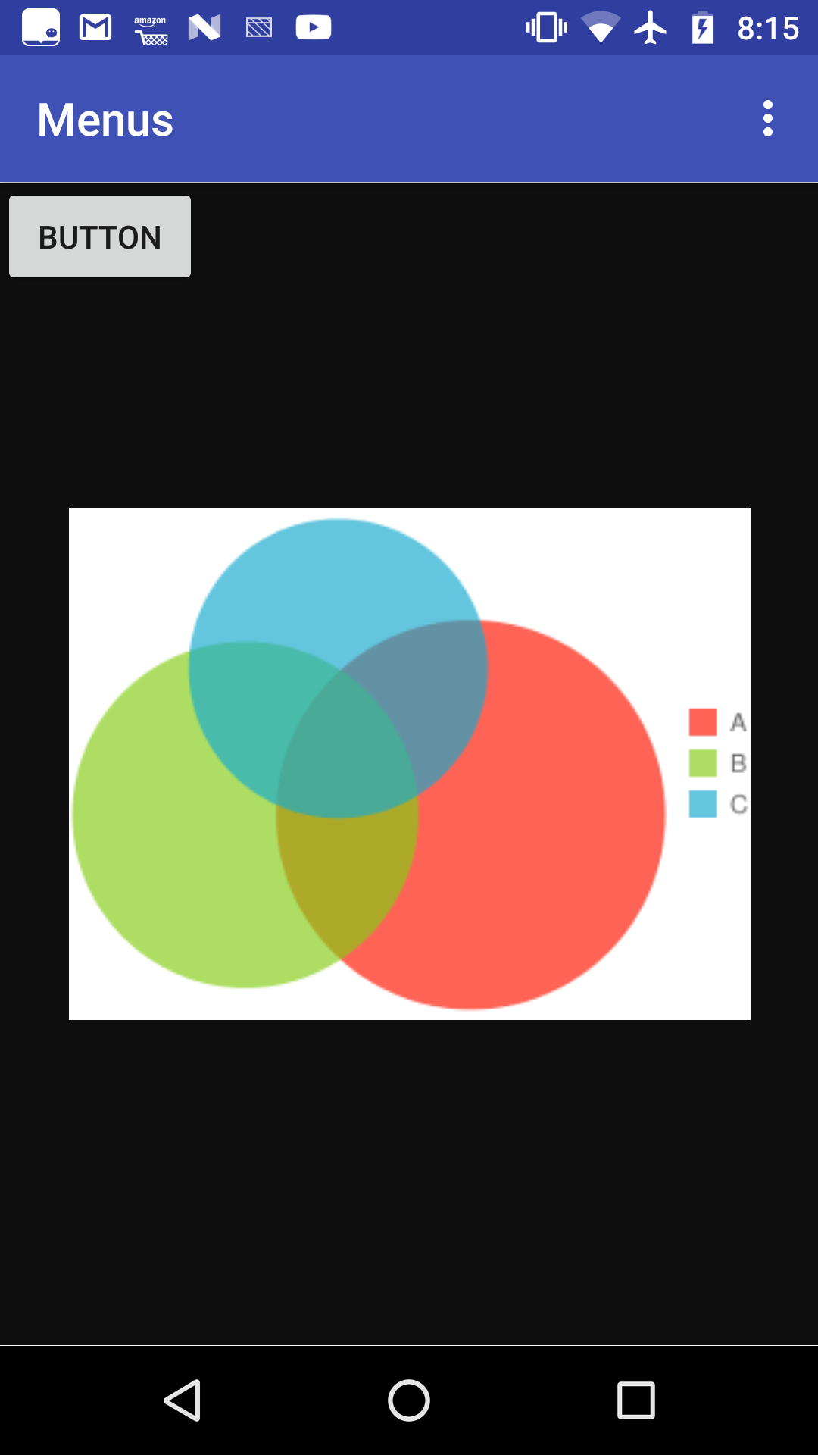
Homework #13
Add a EditText for the user to enter a URL
Place the button on the right of the EditText and rename to “submit”
Add another button beneath the EditText and name it to ”bookmark”
On clicking the submit button, the URL should be displayed in the WebView
On clicking the bookmark button, the current URL should be saved as a bookmark
The menu for the app now should display a list of saved bookmarks
On selecting a saved bookmark, the corresponding webpage should be displayed

